Slide 1
NPDES Boatyard Permit and Stormwater BMPs
Kurt Baumgarten, Gary Bailey and Greg Stegman
November 10, 2011

Slide 2
Main Points for Today’s Talk
The Permit - Overview
Mandatory BMP discussion

Slide 3
The Boatyard General Permit
Sector Specific Permit
Authorizes and regulates the discharge of point source pollution
Implements the National Pollutant Discharge Elimination System

Slide 4
Pollutants of Concern
Copper – bottom paint, propellers
Zinc – zinc anodes, uncoated galvanized surfaces, propellers
Oil and Grease – leaks and spills
Suspended Solids – gravel lots, solids management
Lead – batteries, keel material

Slide 5
Benchmarks and Limits
NPDES - Waste Water Discharge Permit
Benchmarks (Stormwater) - limits based on treatment technology with an allowable period of time to meet those limits with source control methods.
Effluent limits (POTW) – bright line. Exceeding effluent limit is a Permit violation.

Slide 6
Wastewater From Boatyards
Two Main Wastewater Sources:
  1. Pressure wash wastewater
  2. Stormwater runoff
Primary wastewater pollutants:
  1. Metals (copper, zinc, lead) µg/L
  2. Total suspended solids (TSS) mg/L
  3. Oil/grease mg/L

Slide 7
Pressure Wash Water Disposal
Discharge of water to surface water prohibited
Most yards have closed loop wash water recycle system (pre-treatment)
Spent wash water is trucked to POTW or discharged to sanitary (with approval)

Slide 8
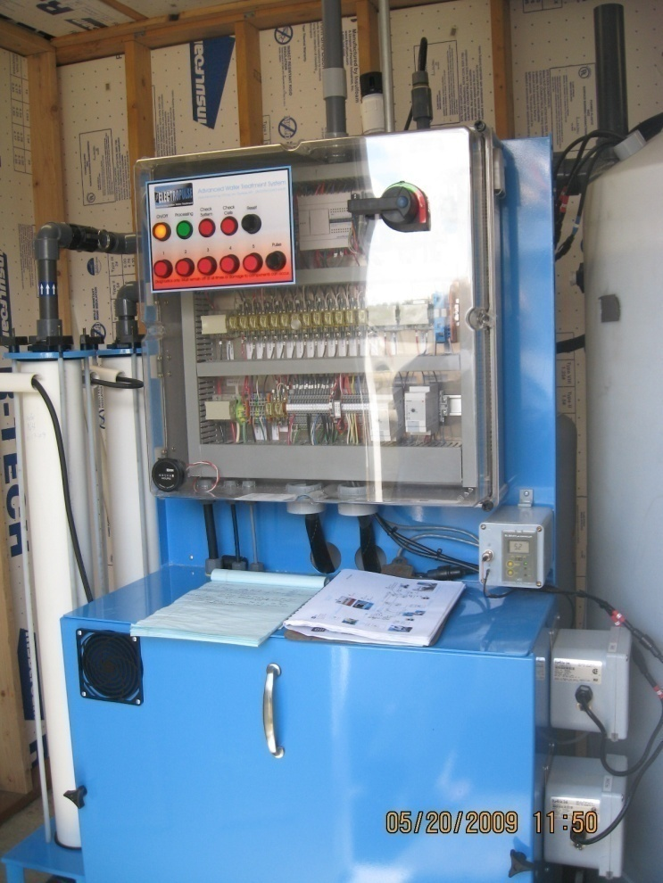
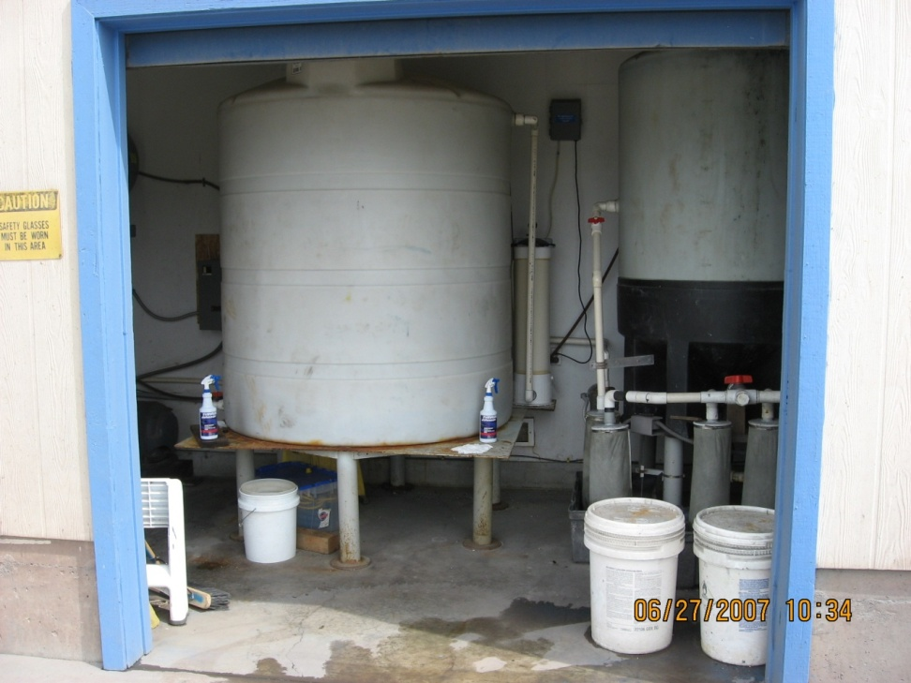
Closed Loop Systems

Slide 9
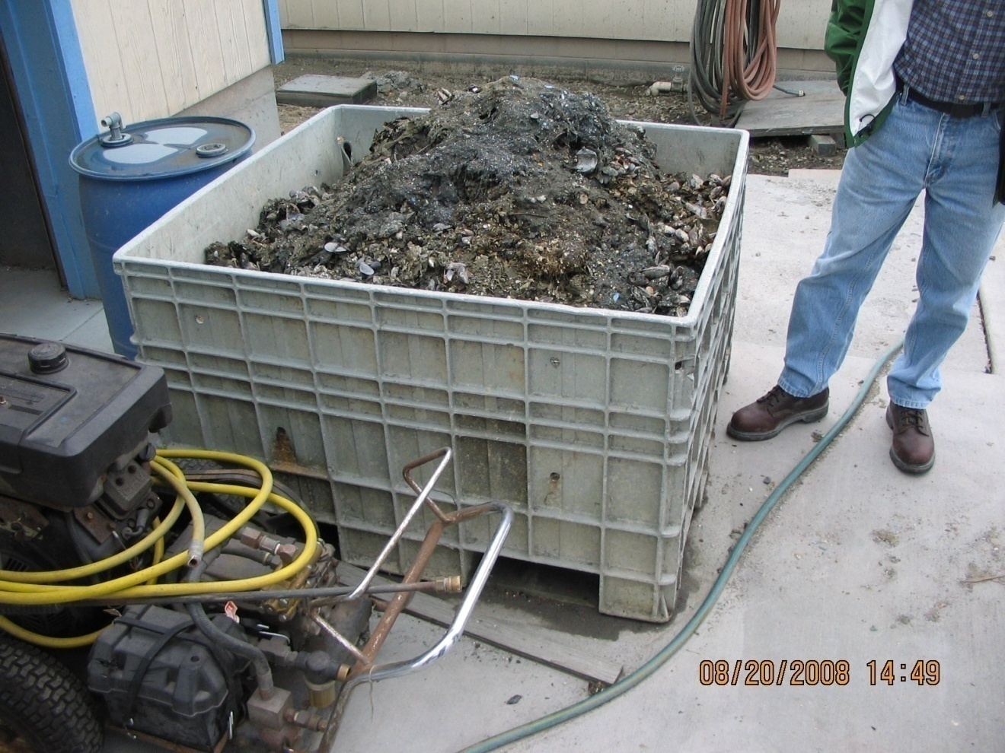
Pressure Wash Solids

Slide 10
Pressure Wash Sludge Disposal
Sludge – Likely a ”State Only Dangerous Waste”
Either assume sludge is a ”State Only Dangerous Waste” or have fish bioassay done to verify
Vacuum sander dust should be treated the same
Info:http://www.ecy.wa.gov/programs/hwtr/manage_waste/des_intro.html

Slide 11
Sampling
Pressure wash wastewater:
  One sample/month: June, July, August, and September
  Compare to effluent limit
Stormwater:
One sample/month: October, November, January, April, and May
Benchmark – seasonal average and max daily

Slide 12
Effluent Limits – POTW
Parameter | Maximum Daily
Total Copper (mg/L) | 2.4
Total Zinc (mg/L) | 3.3
Total Lead (mg/L) | 1.2
pH | 5.0-11.0

Slide 13
Benchmarks - Stormwater
Fresh and Marine Water - Grab
Parameter | Seasonal Average | Maximum Daily (avg.)
Total Copper (µL) | 50 | 147
Total Zinc (µL) | 85 | 90

Slide 14
Additional Sampling
One time sampling winter 2012 for:
BOD, Nitrate / Nitrite (marine)
BOD, Phosphorus (fresh water)
Any additional sampling must be included in the DMR

Slide 15
Values Above Benchmark
The response to ANY monitoring result above a benchmark value for each DMR:
Level One Response:
  Inspection to evaluate possible sources
  Identify source /operational control methods
  Evaluate whether any improvements or changes to the stormwater pollution prevention plan are required
  Summarize the inspection results, including remedial actions taken, if any, and place them in the SWPPP and DMR

Slide 16
Values Above Benchmark
The response to FOUR monitoring results for a parameter above benchmark values:
Level Two Response:
  complete the requirements for level I response.
  evaluate treatment practices or structures
  submit a level 2 report to Ecology within three months

Slide 17
Values Above Benchmark
The response to SIX monitoring results for a parameter above benchmark values:
Level Three Response:
  Complete the requirements for level I response.
  Prepare an engineering report (WAC 173-240, guidance, contact Ecology).
  Submit within 3 months.
  Implement treatment or treatment BMP within 12 months.
Any facility that is required to produce a level 2 or level 3 report in the previous permit retains that obligation in the new permit.

Slide 18
Financial Hardship Certification
Submit signed certification (with the engineering report) that the facility cannot afford the treatment necessary to meet benchmarks.
Request a period of time to finance the treatment - compliance schedule
Ecology reviews and issues Administrative Order with compliance schedule

Slide 19
Mandatory BMPs
  BMP Education
  Vacuum Sanders
  Tidal Grids
  In-water Vessel Maintenance and Repair
  Upland Vessel Maintenance and Repair
  Solids and Chemicals Management
  Paint and Solvent Use
  Oils and Bilge Water Management
  Sacrificial Zinc Management
  Sewage and Gray Water Discharges
  Wash Pad Decontamination

Slide 20
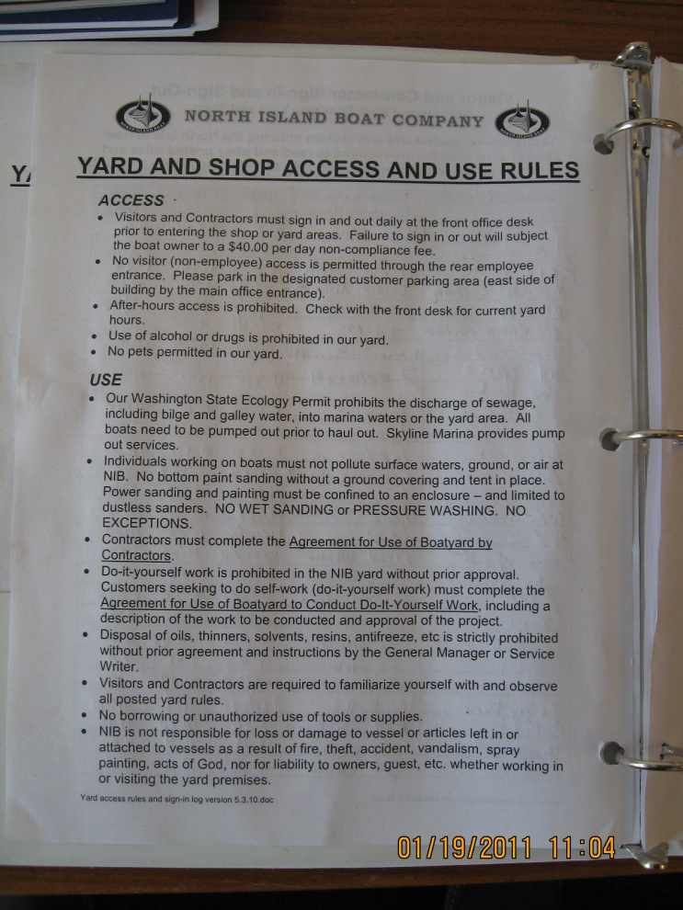
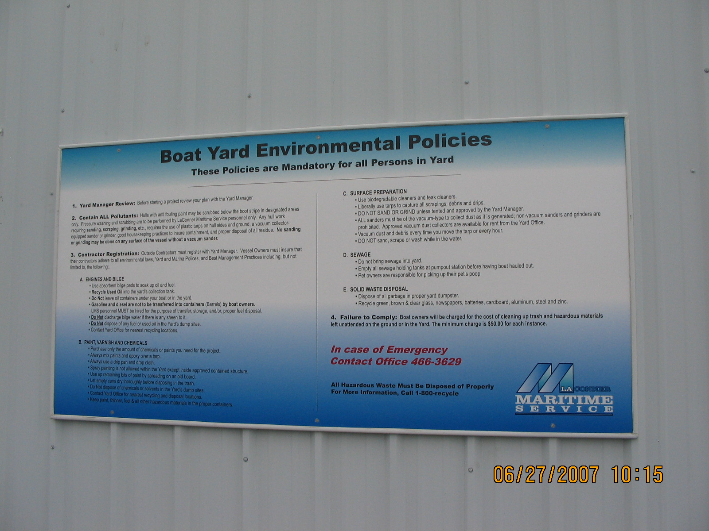
BMP Notices

Slide 21
Mandatory BMPs
Vacuum Sanders
Required for all bottom preparation
Process for approval of alternatives
Treat dust from hulls like pressure wash sludge

Slide 22
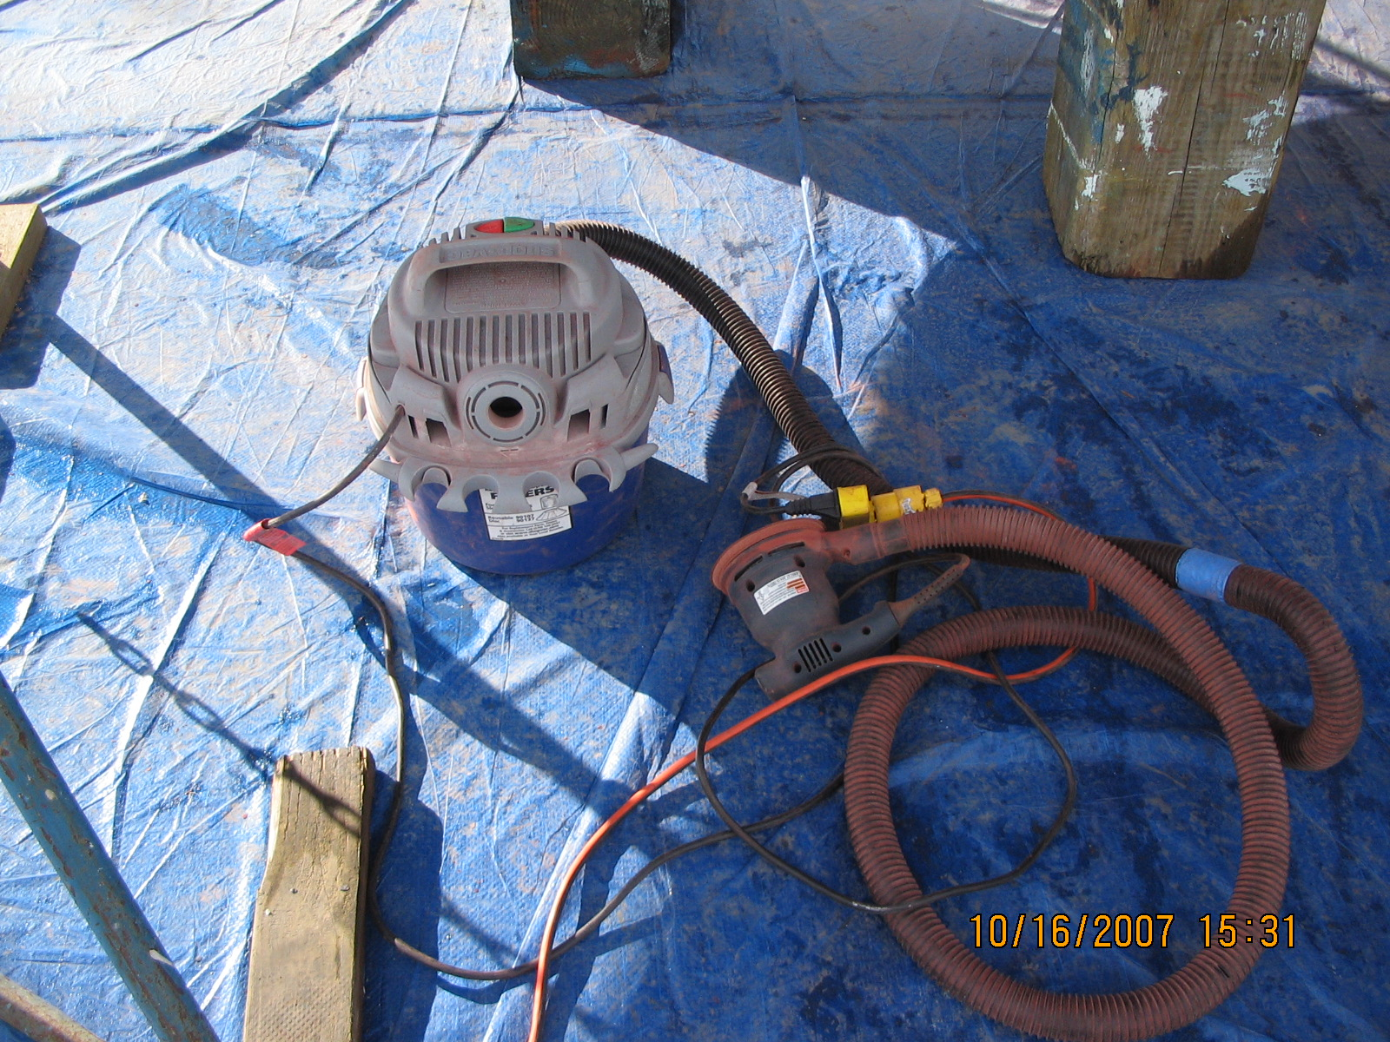
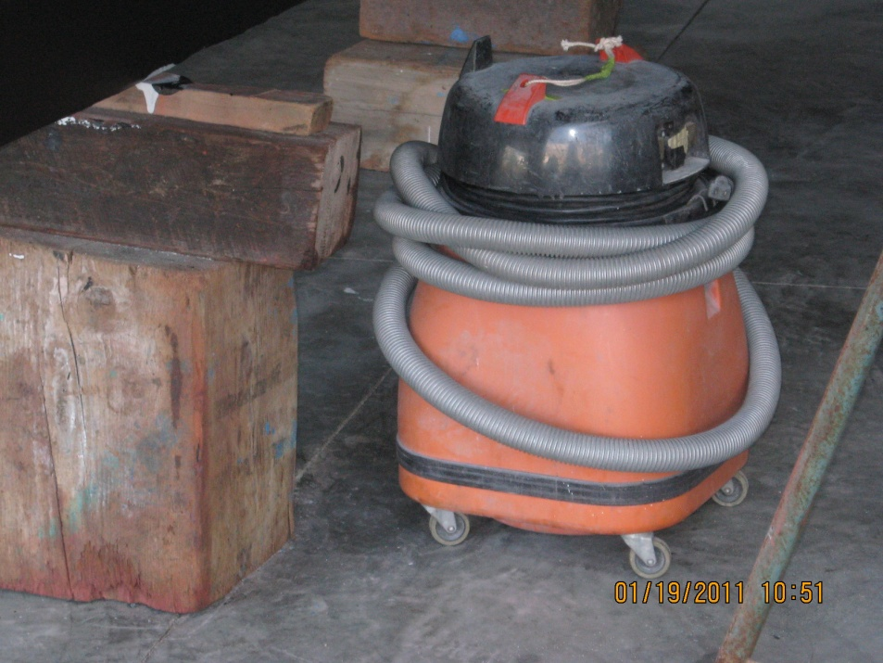
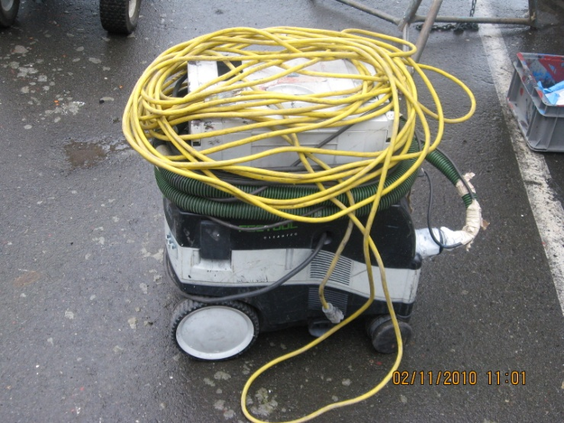
Vacuum Sanders

Slide 23
Mandatory BMPs
Tidal Grids
Visual inspection and emergency repair
In-water Vessel Maintenance and Repair
No hull work or work from float
Limited to 25% of topside
Collect all debris

Slide 24
Mandatory BMPs
Upland Vessel Maintenance and Repair and Solids Management
Prevent the release of all particles, oils, grits, dust, flakes, chips, drips etc. to environment and waters of the state – collect once a day if necessary
Tarp, tent, drip trays, vacuum, sweep etc.
Marine railway – no over water work (one boat length rule)

Slide 25
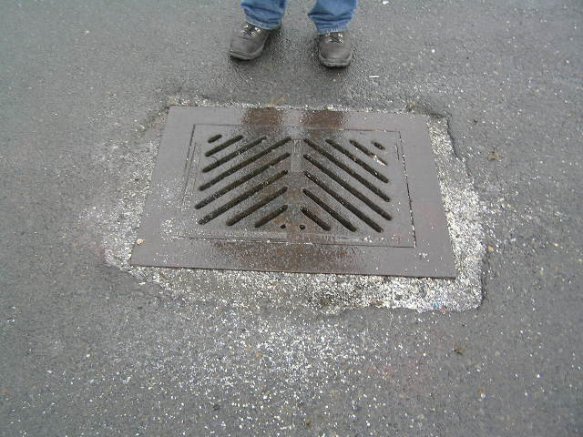
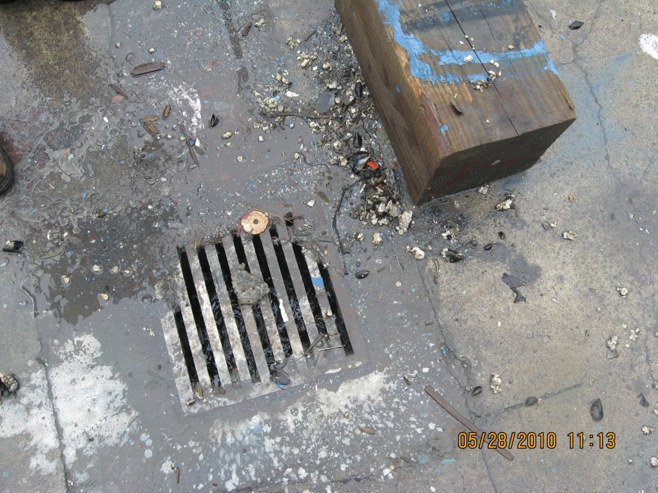
Solids Management

Slide 26
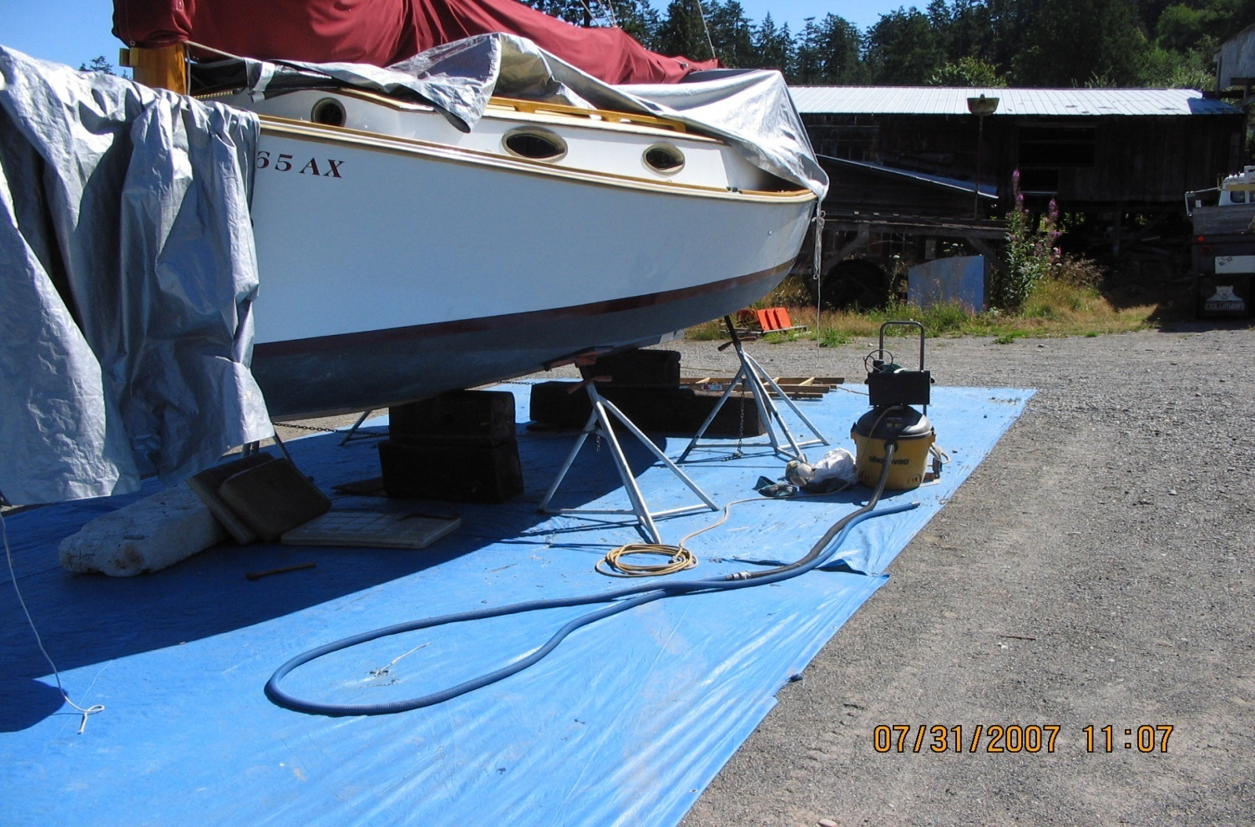
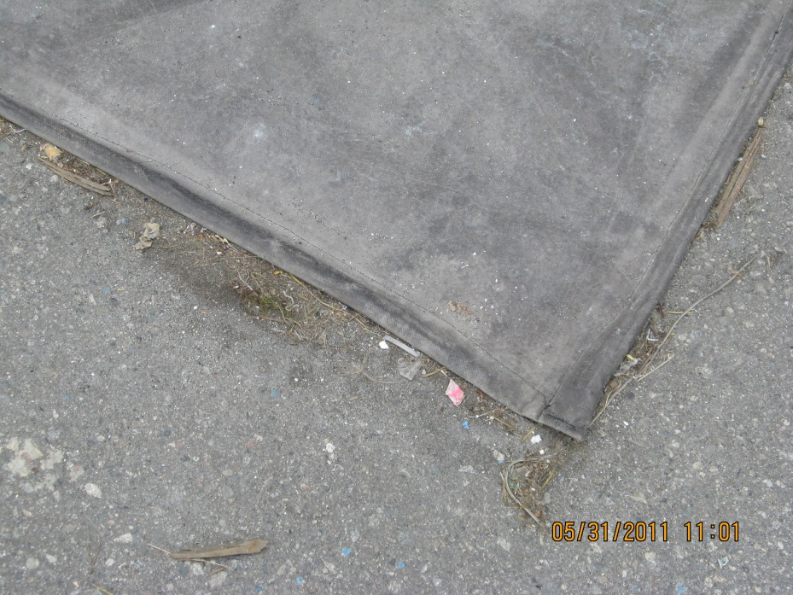
Solids Management

Slide 27
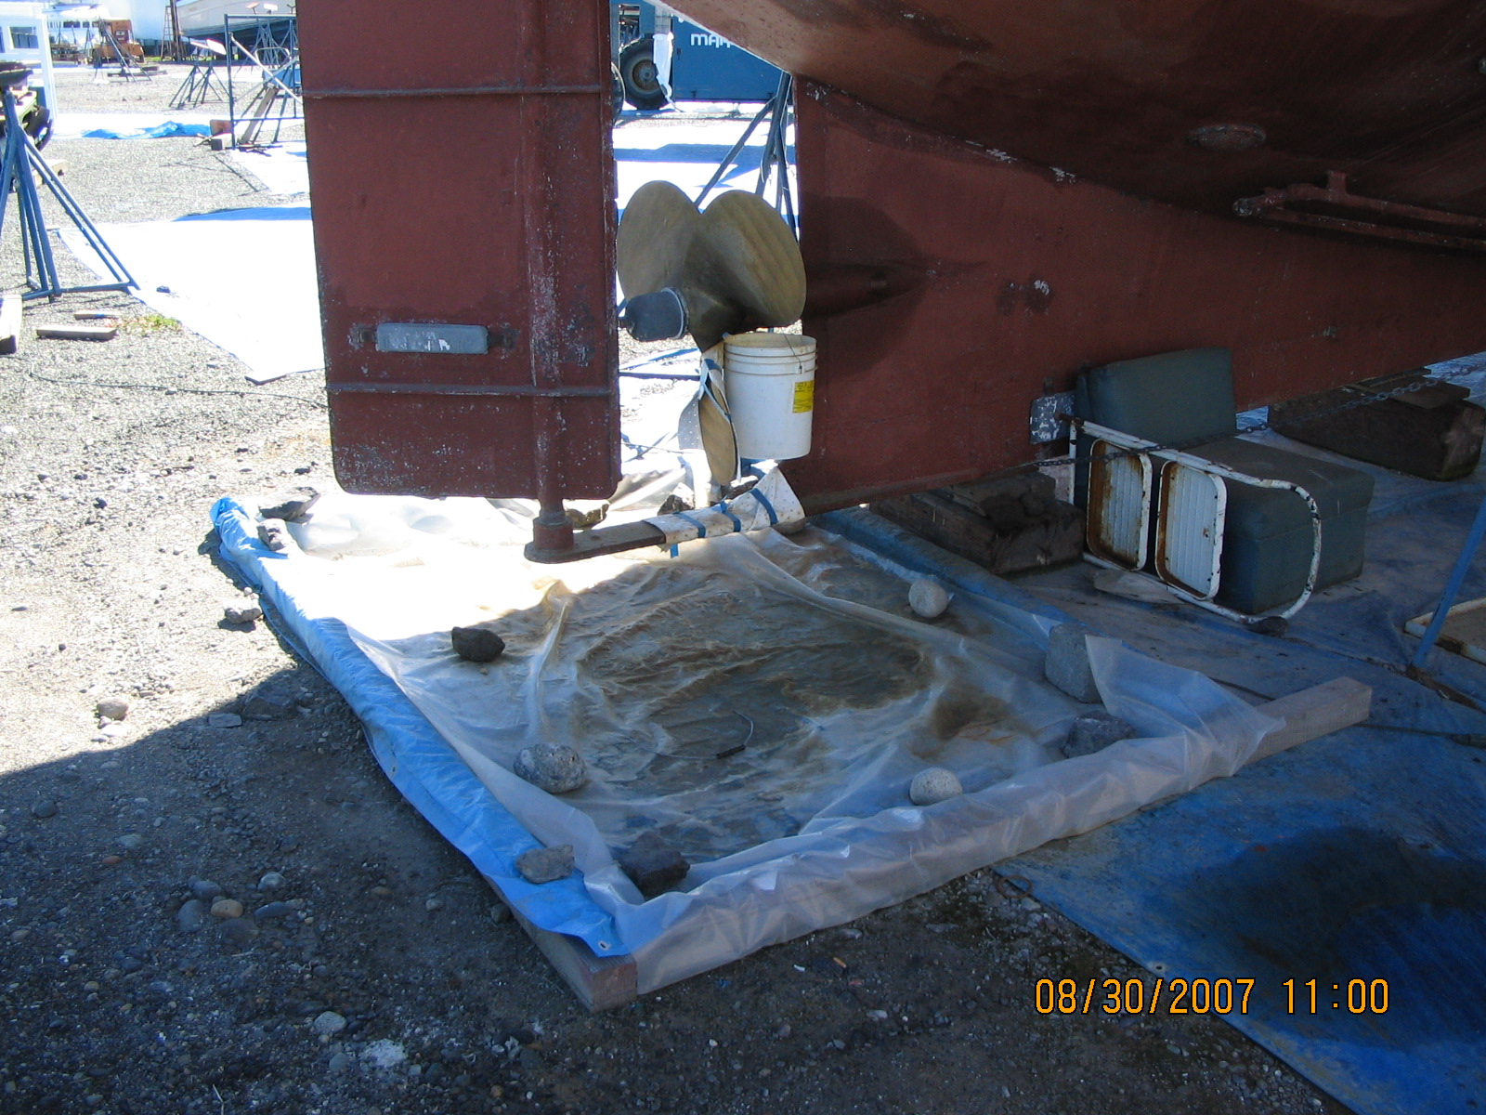
Solids Management

Slide 28
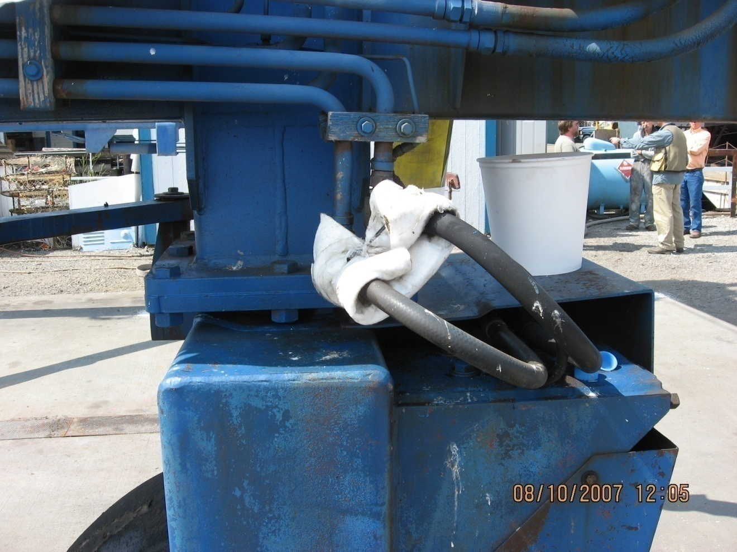
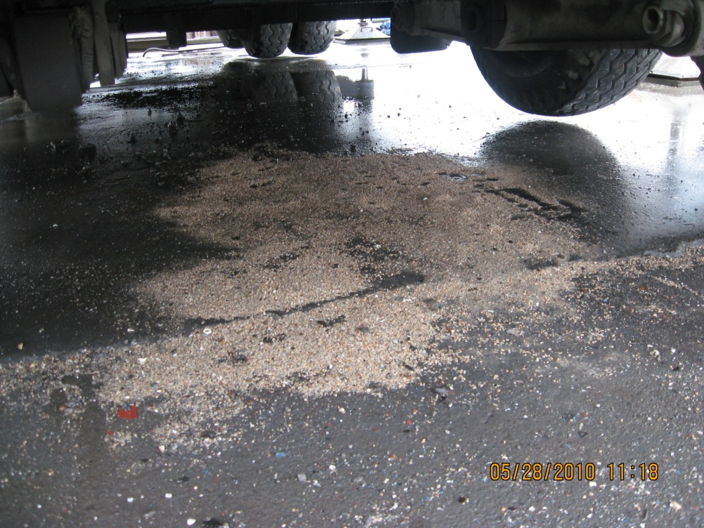
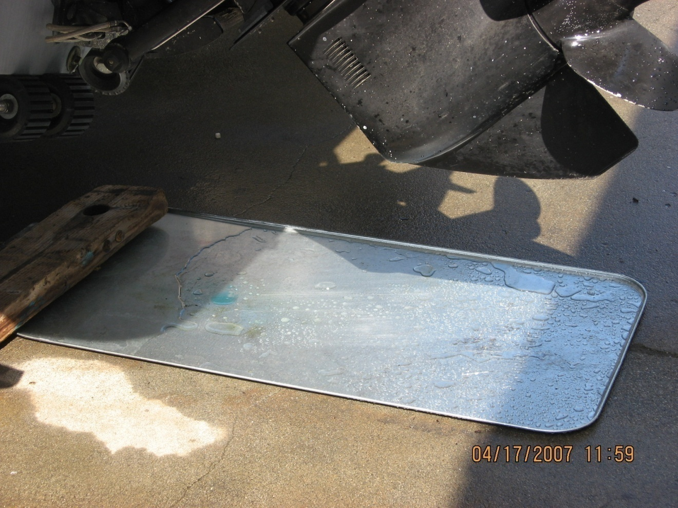
Leaks and Spills

Slide 29
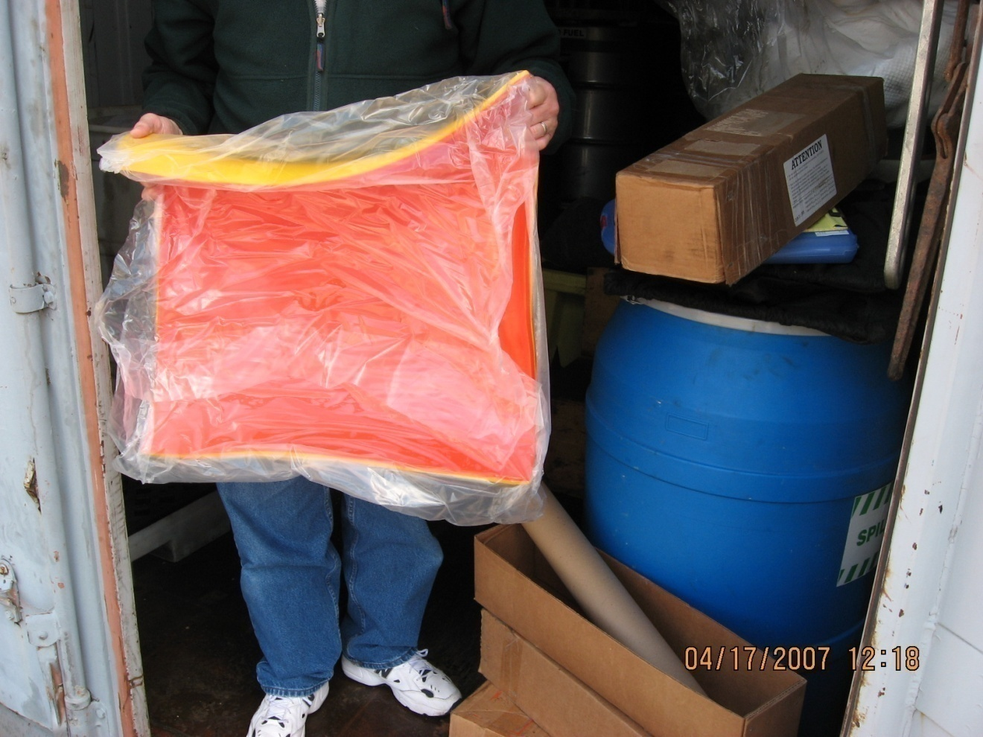
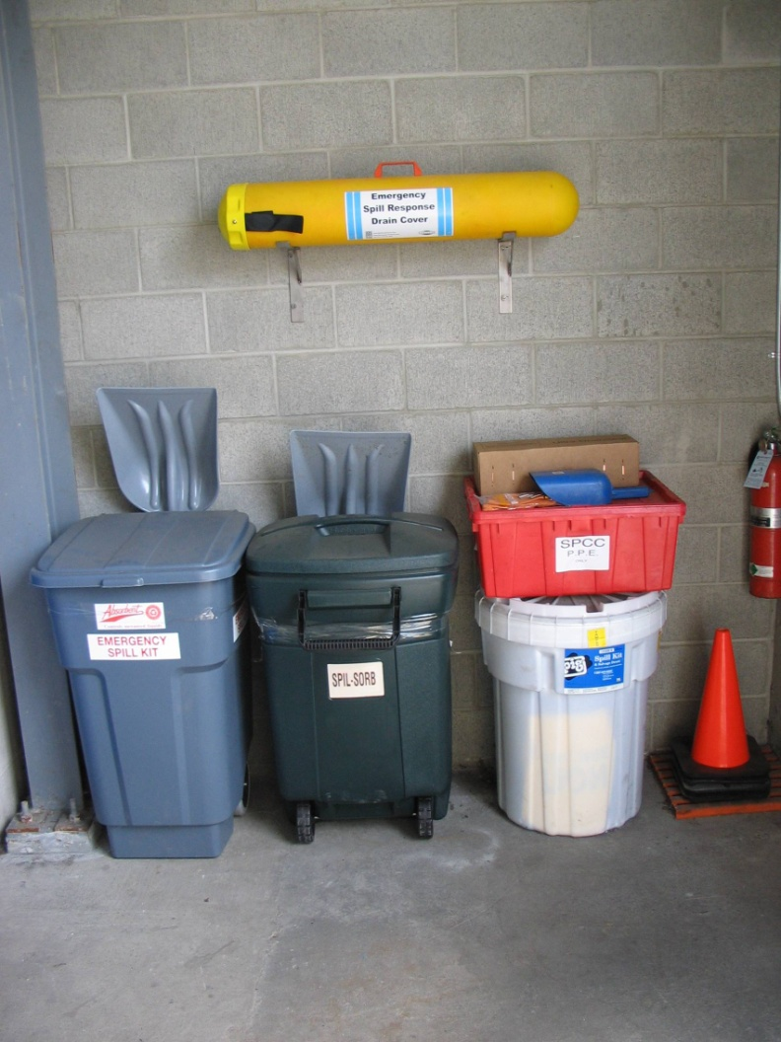
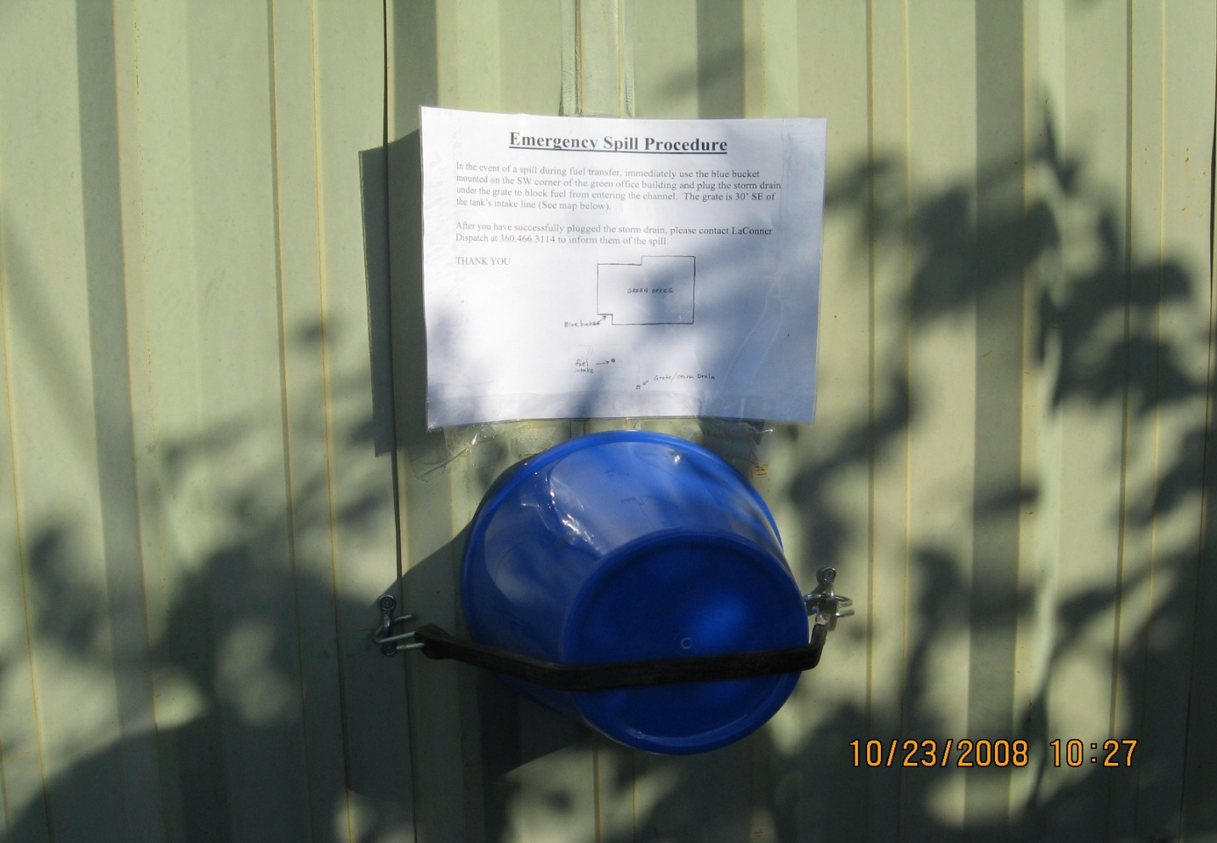
Spills

Slide 30
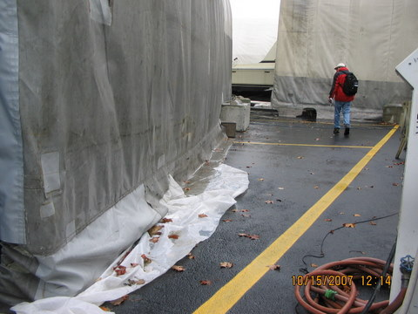
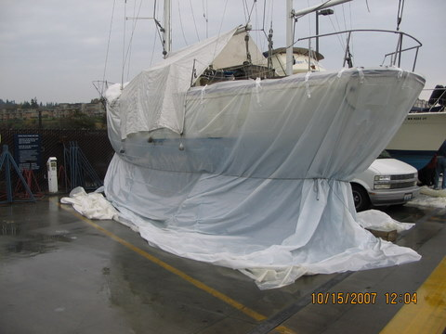
Covered Work Area

Slide 31
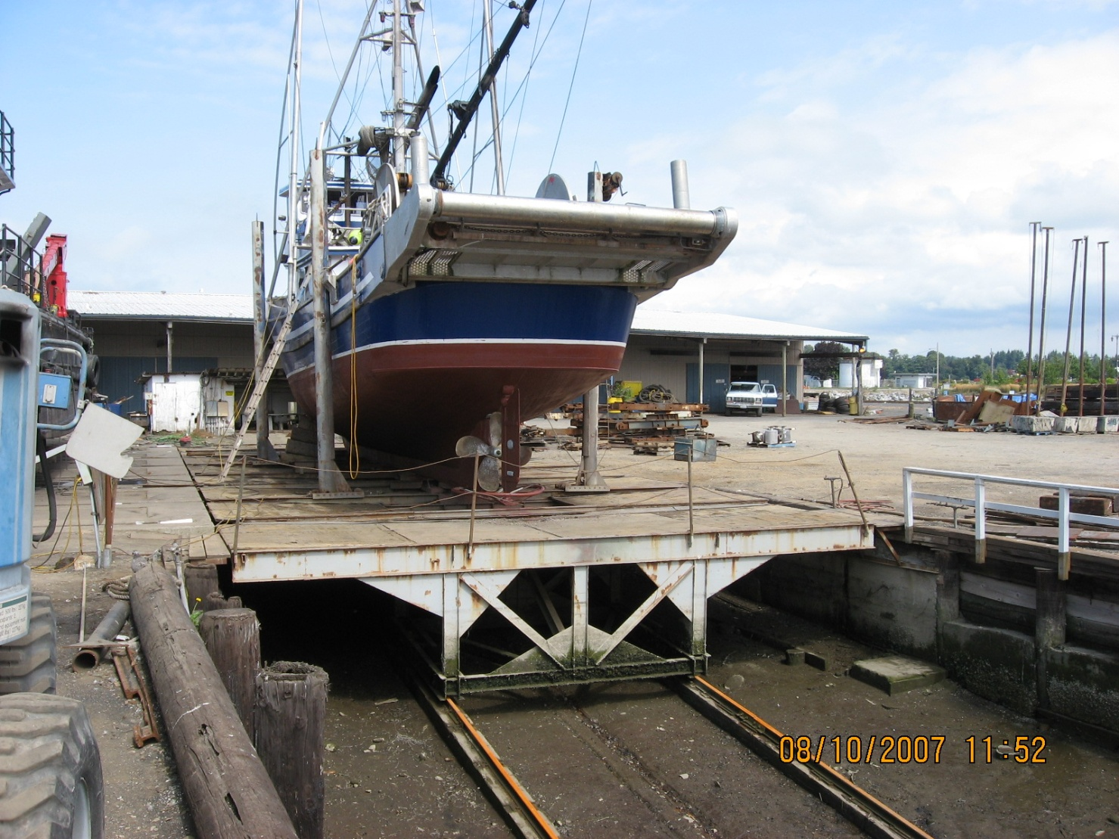
Marine Railway

Slide 32
Mandatory BMPs
Paint and Solvent Use
Prevent release to environment and waters of the state
Tarps and trays
Mix or transfer with pans and trays
Painting over or near water prohibited except for touch-up, letters, numbers, etc

Slide 33
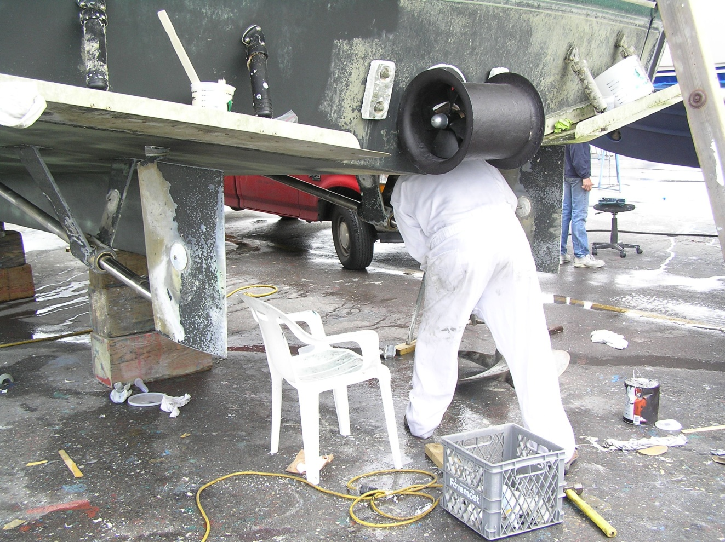
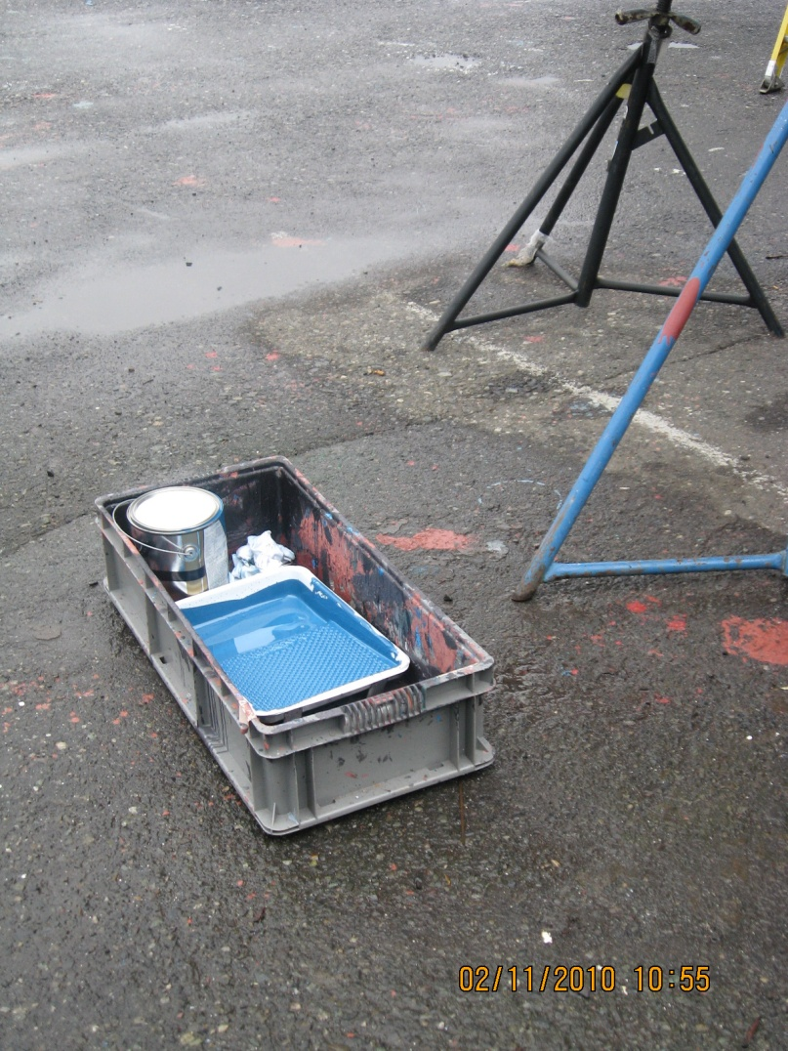
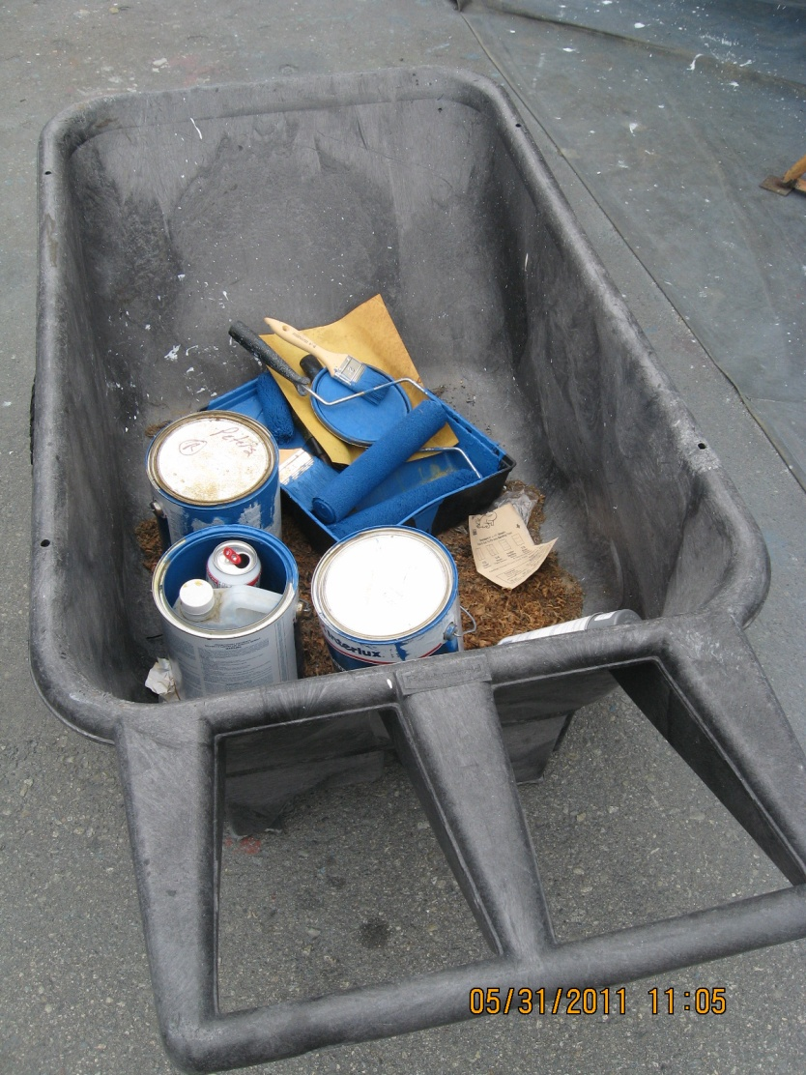
Paints and Solvent Use

Slide 34
Mandatory BMPs
Oils and Bilge Water Management
No sheen
No soaps, dispersants, emulsifying agents
Drip pans and containment for any fuel transfers
Pads and boom available

Slide 35
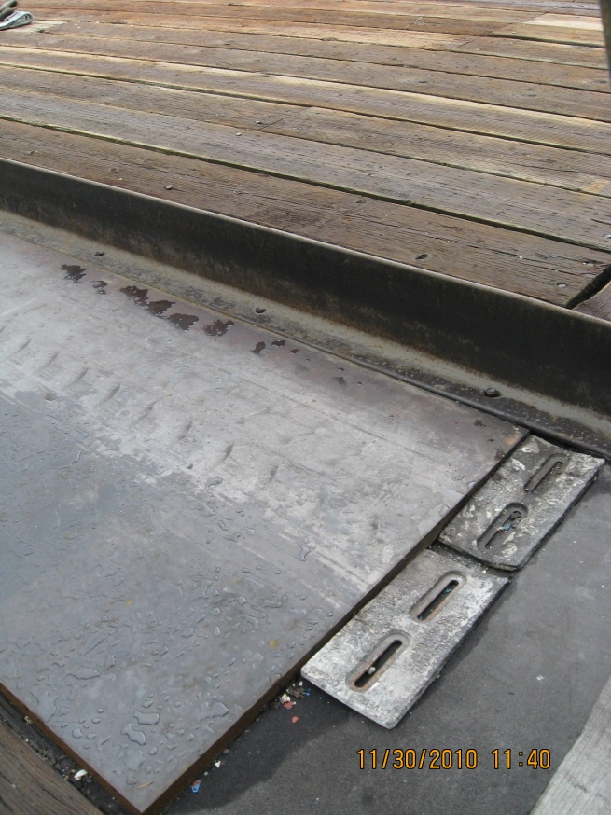
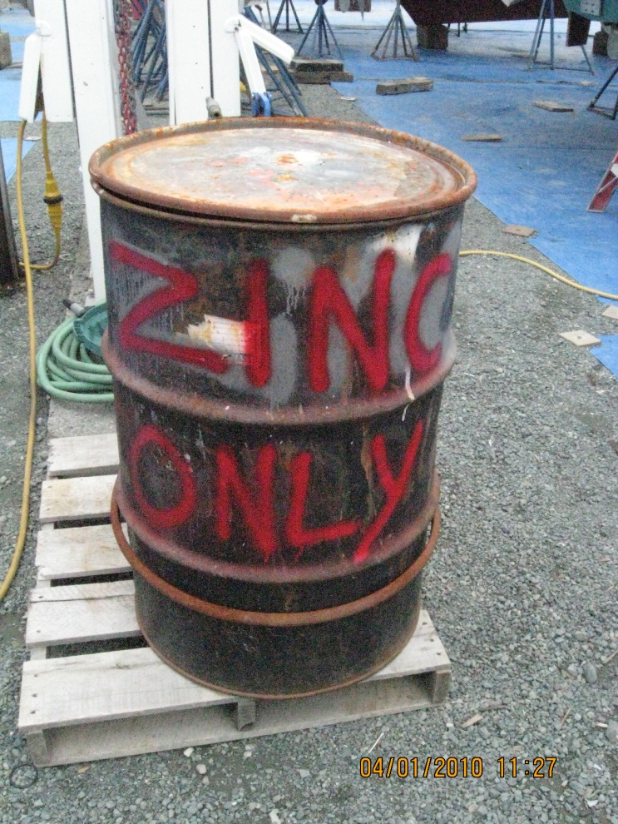
Mandatory BMPs
Zincs
Keep out of stormwater
Store in covered container
Recycle

Slide 36
Mandatory BMPs
Chemical Management
Store under cover and on an impervious surface
Containment for liquid chemicals stored near storm drains
Batteries, lead and copper waste

Slide 37
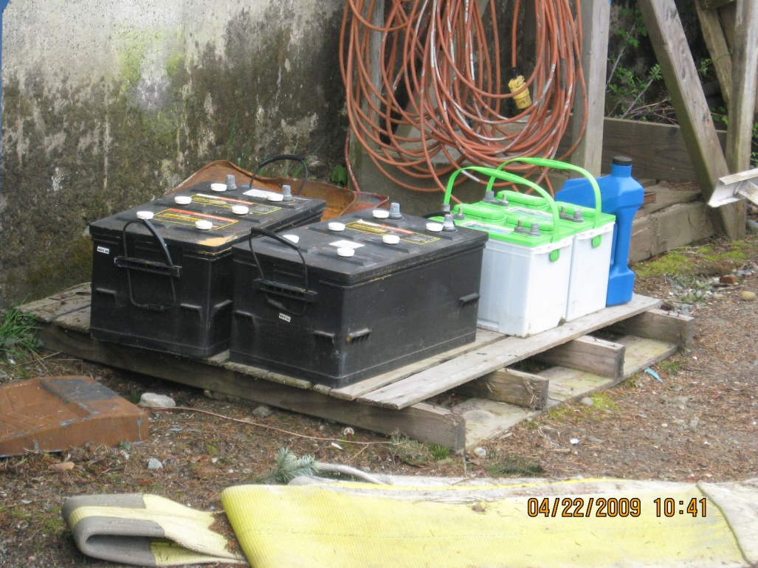
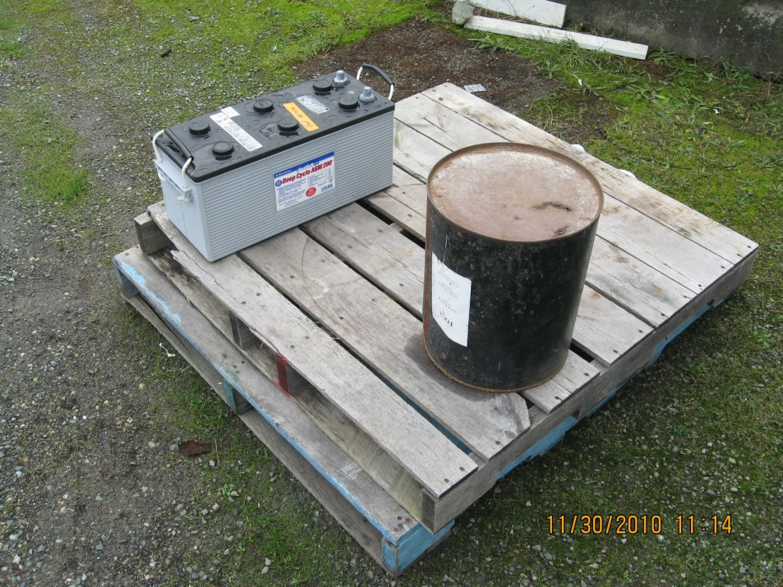
Battery Storage

Slide 38
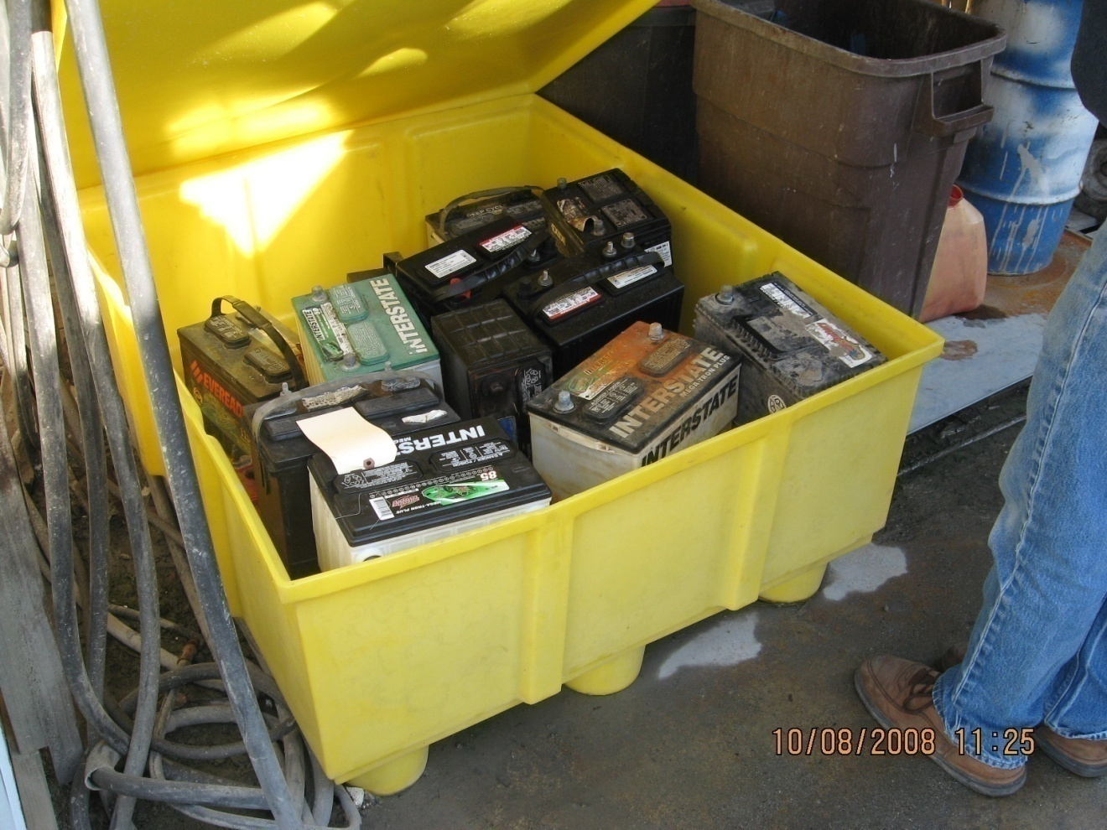
Covered Battery Storage

Slide 39
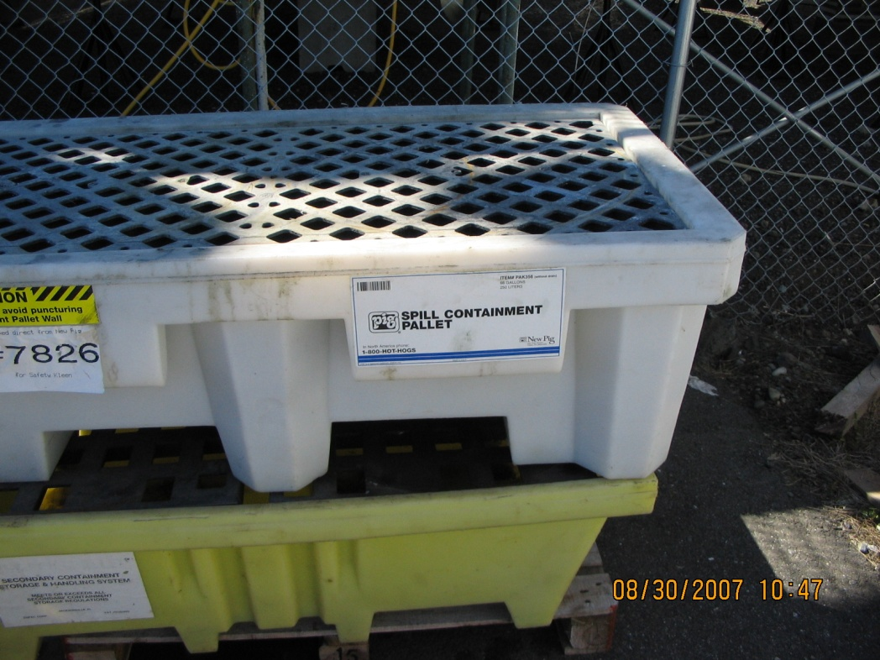
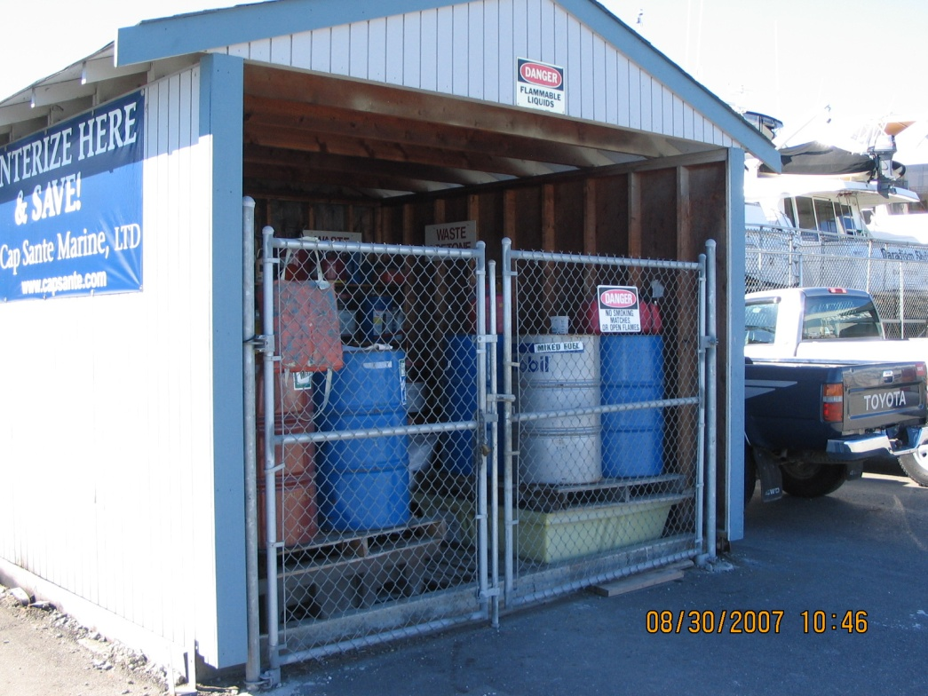
Secondary Containment

Slide 40
Mandatory BMPS
Wash Pad Decontamination
Clean pad prior to actively pumping or passively discharging to waters of the state
Clean sump of all debris
Ensure valve or bypass is set correctly

Slide 41
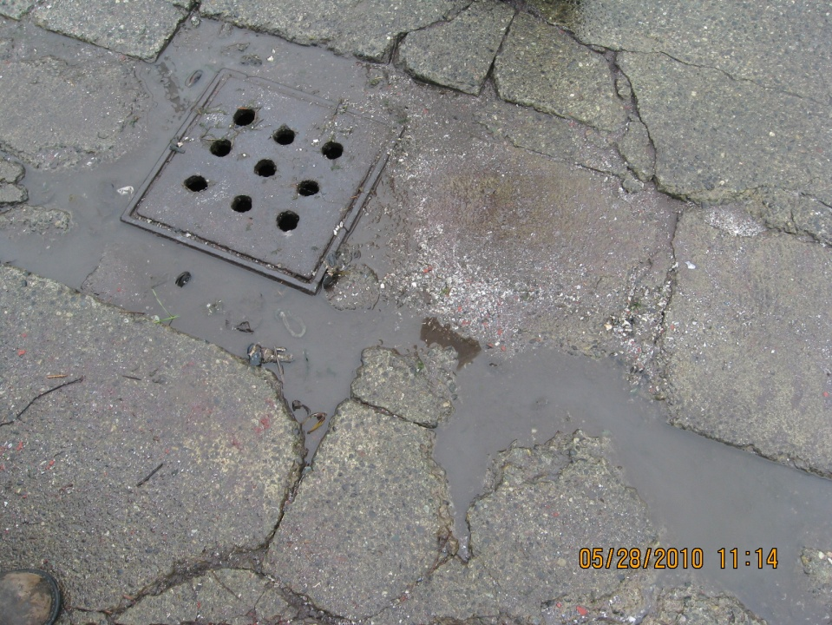
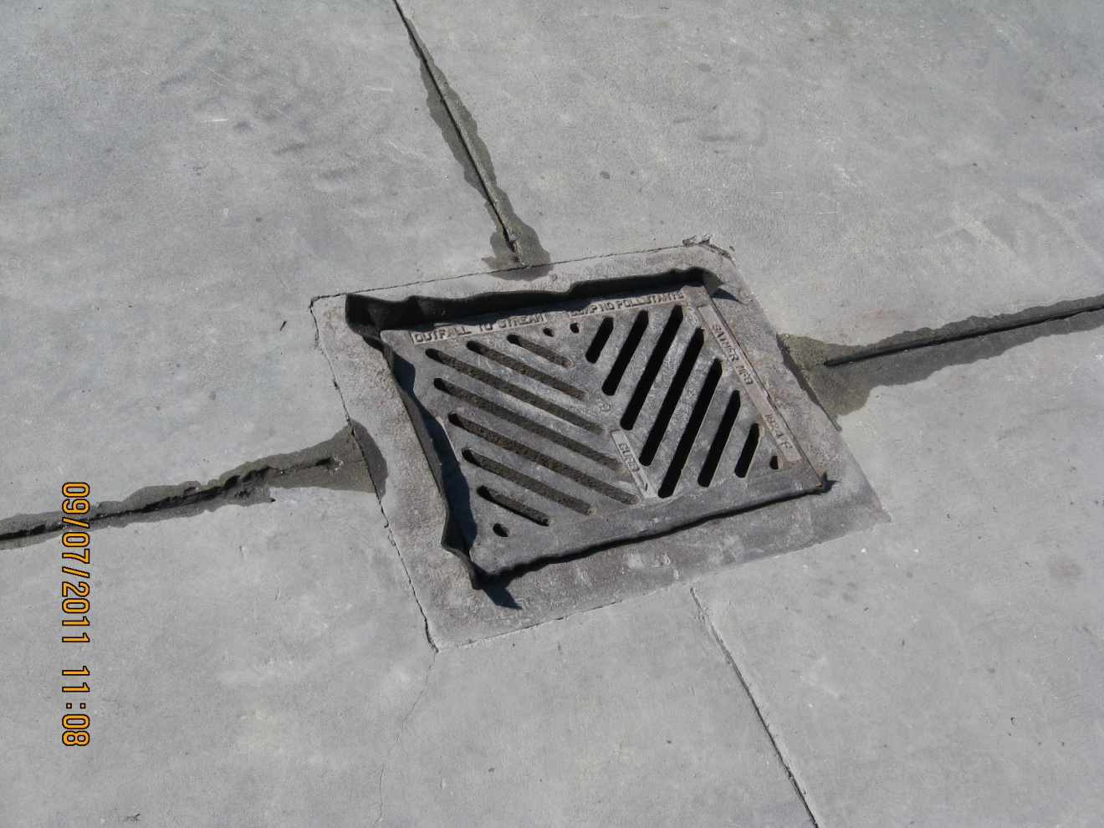
Wash Pad Cleaning

Slide 42
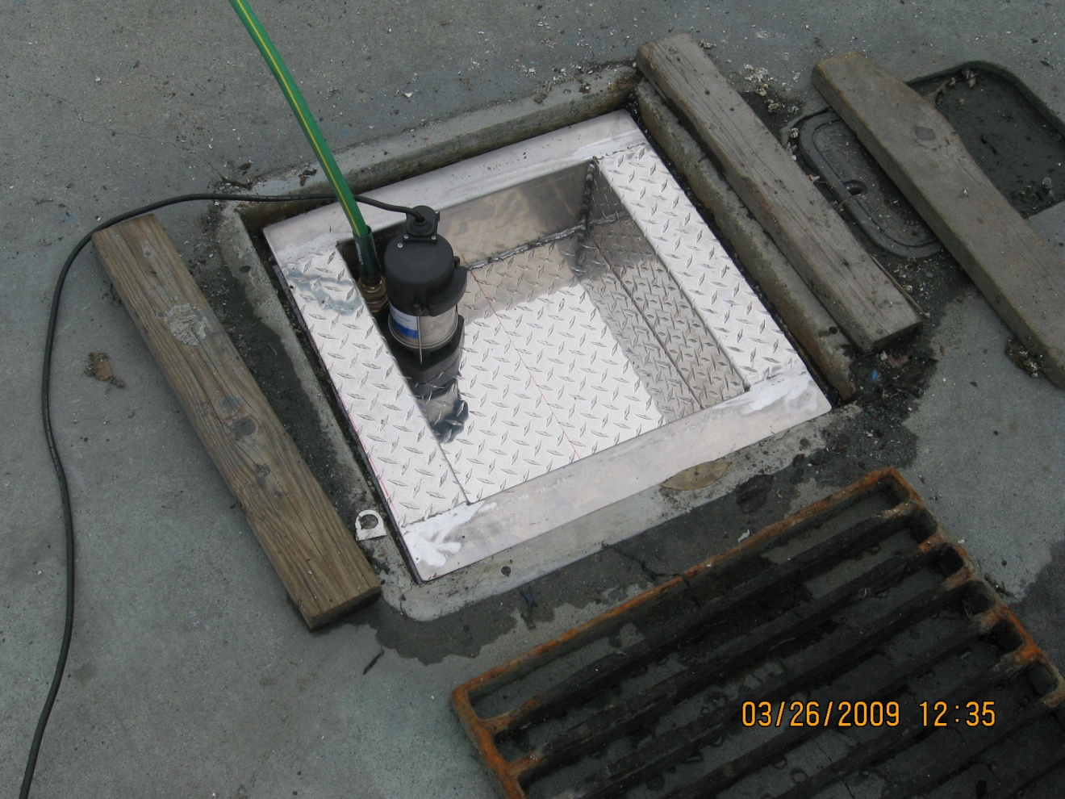
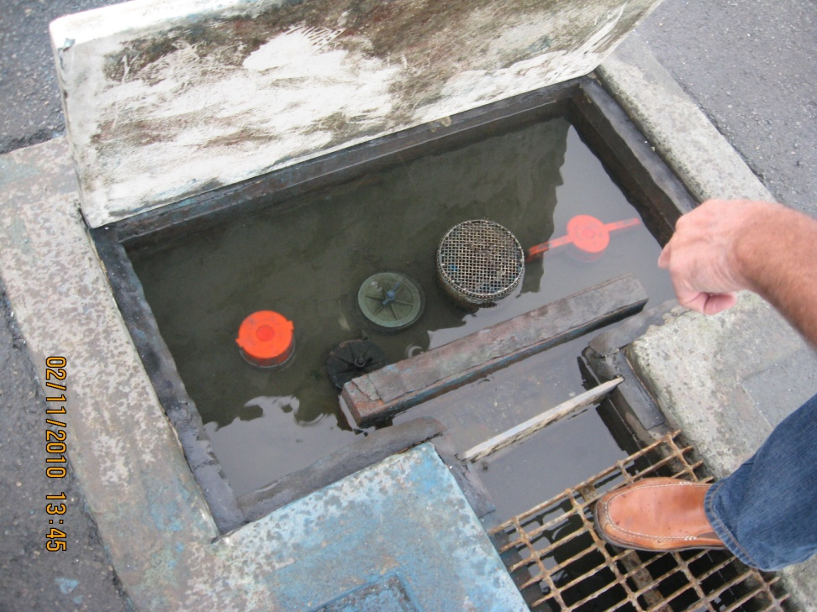
Wash Pad Discharge

Slide 43
Mandatory BMPs
Sewage and Gray Water Discharges
Discharge prohibited
Written notice to customers

Slide 44
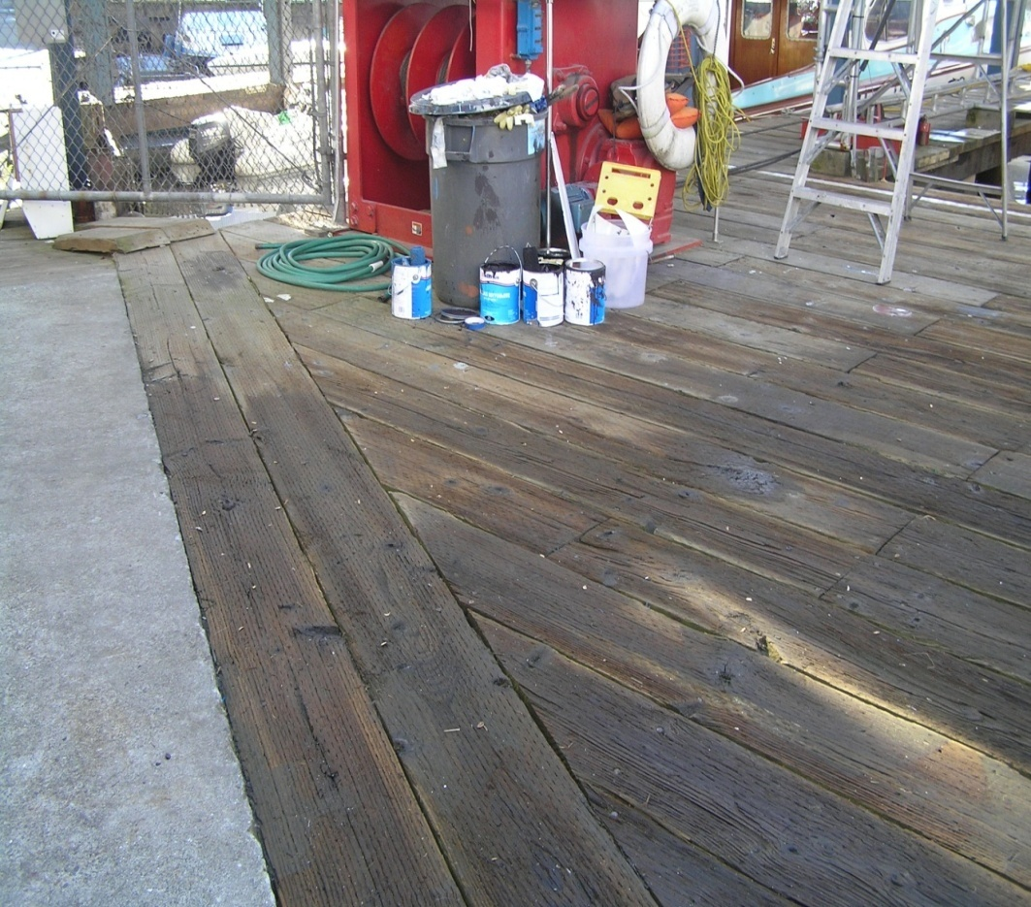
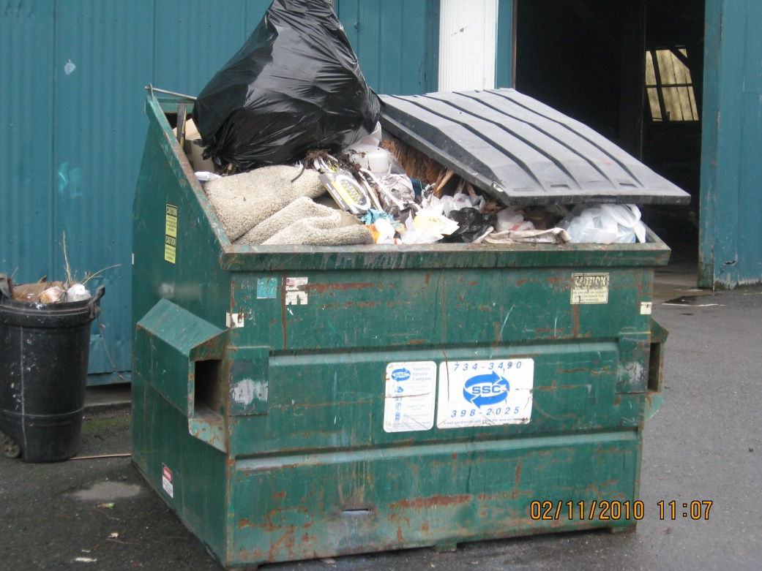
Solid Waste

Slide 45
Visual Monitoring - Inspections
Weekly by qualified staff – Inspection Checklist
Sampling location – floating material, oil and grease, turbidity, odor, etc. – correct and record
Illicit Discharges
BMP operation and maintenance
Update site map and SWPPP as needed

Slide 46
SWPPP
Facility description and evaluation, BMPs
Monitoring and Spills plan – Pollution Prevention Team
Records of employee training, inspections
Receipts for BMP implementation
Updated as needed based on inspections and responses to samples over benchmarks

Slide 47
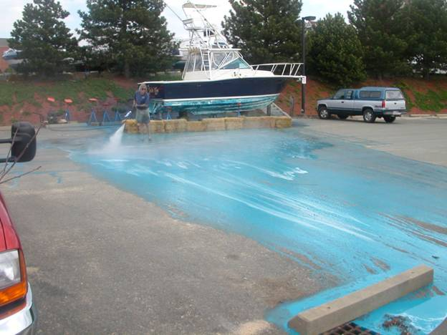
QUESTIONS?

